Slide 1


Tickets Marchee
PHP FULL STACK DEVELOPMENT - 3 MONTHS TRACK
Group Names:-
Hagar Hosny Gad Omar Mahran
Kareem Asharf Mohamed Maged Manar Ali
20/11/2022

Slide 2
Outline
Background of the problem.
Competitors customers analysis
Proposed solutions
Tools & Technologies
System Architecture
project Demo
Presenting the project

Slide 3
1.Background of the problem.
supplying entertainment houses, venue owners, event organizers and planners, with an easy and feasible solution to sell and market their tickets/invitations.
Tickets marchee is build to sell tickets of available events in egypt.
The main purpose in addition to gaining money is to spread different cultures by introducing multicultural shows & events tickets for sale.
Reaching interested clients all over egypt and keep them updated with the current events is the goal.
The website is applicable to all ages & genders who can use technology in general.

Slide 4
“ In today's world where technological breakthroughs dominate our lives, it has become important that entertainment houses and event venues adopt such technological innovations in running their businesses.” Tickets Marchee
Tickets Marchee

Slide 5
Competitors customers analysis
Tazkarti VS Tickets Marchee
 | Tickets Marchee | Tazkarti
Easy use | √ | √
Privacy & security | √ | √
Theater Tickets | √ | X
Kids Events | √ | √
Singers Events | √ | Only During Summer
Venues Events | √ | X
Cultural Events | √ | X
Sports Events | √ | √
E-Ticekts | √ | √

Slide 6
Proposed solutions
How it works
Ticketsmarche.com acts as an agent to the event providers or planners such as venues, teams, artists' reps, fan clubs, promoters, and leagues. When you order a ticket for a certain event that is located in Egypt, then Ticketsmarche.com will be handling the transaction and collecting the ticket price for the event provider.

Slide 7
4.Tools & Technologies
Used Tools And Technologies
Our Project was built as a dynamic website .
we used Angular Framework as a Frontend for our project with the addition of using HTML & CSS for the design & Typescript(JS).
we used Laravel Framework as a Backend for our project with the addition of PHP programming Language and MYSQL DB (MariaDB).
we used Github for git VCS to pass code between team members and teamwork collaboration .

Slide 8
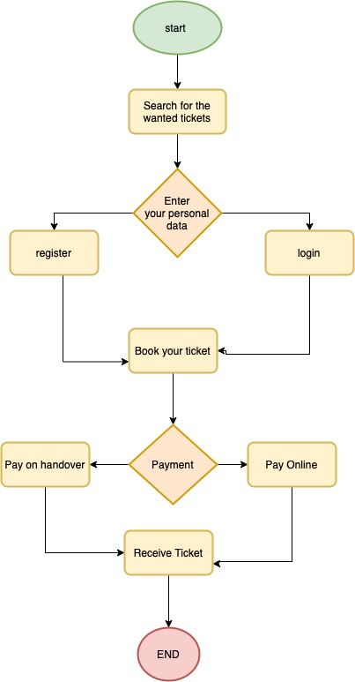
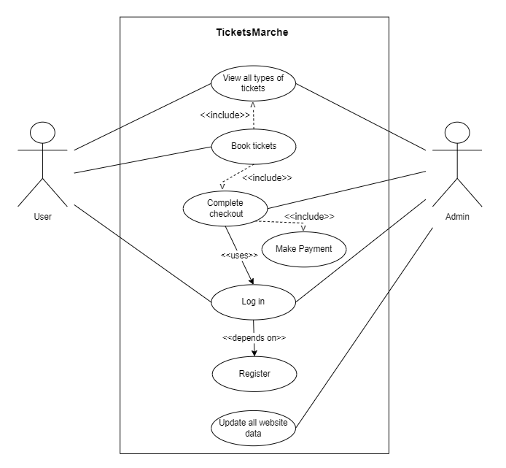
5.System Architecture

Slide 9
6.Project Demo
The Video

Slide 10
7.Presenting the project
The Website Link

